Slide 1
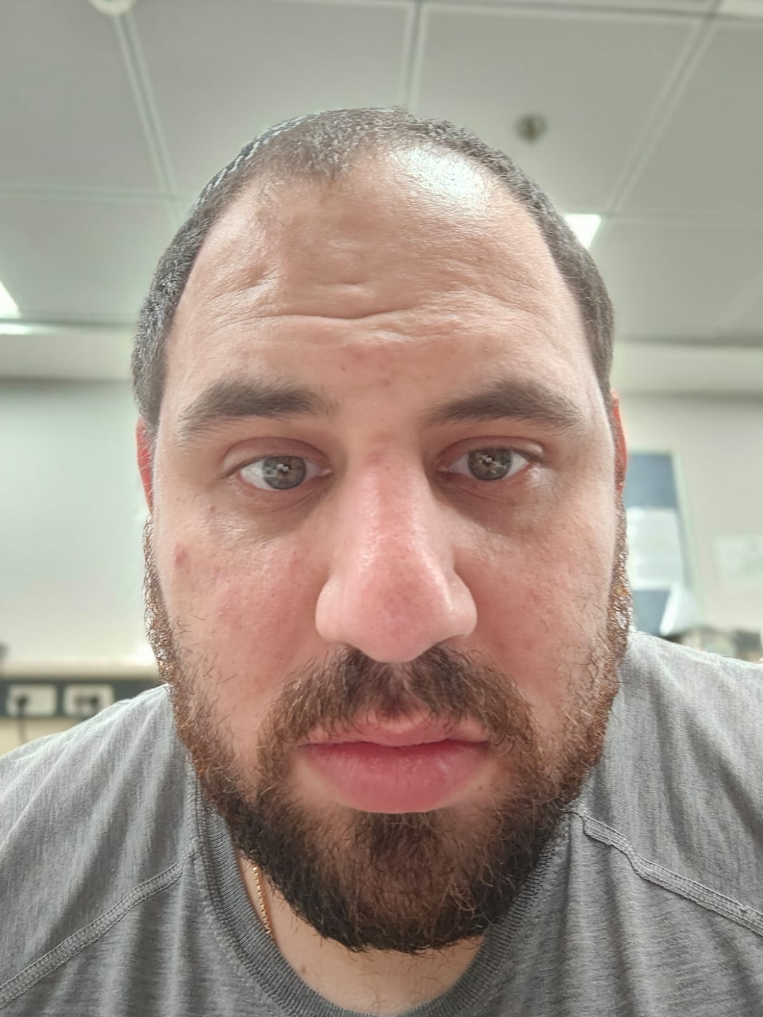

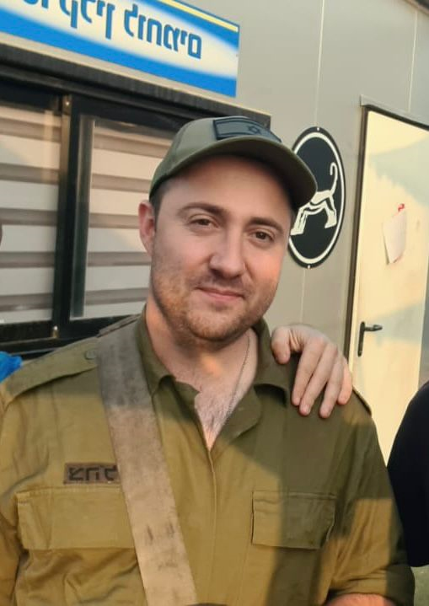
Course: Image Processing 31651 Assignment #24 Pixel to Pixel Operations (Part 4)
1
Photo of the student | Shorten Name | ID (4 last digits)
 | shienfeld | 1950 | Student #1
 | pony | 2210 | Student #2
 | akimov | 7939 | Student #3
Photo of the student | Shorten Name | ID (4 last digits)
 | shienfeld | 1950 | Student #1
 | pony | 2210 | Student #2
 | akimov | 7939 | Student #3

Slide 2
